Slide 1
Sravya Reddy Pilli - 700747154 HarshaVardhan Reddy Pattepur - 700754833, Sai Vardhan Reddy Narra -700756163
Tomato Leaf Disease Detection Using Deep Learning

Slide 2
Role/Responsibilities and Contribution in project
Sai Vardhan Reddy Narra
Management and Augmentation of Datasets: Their work included extensive management of the data collection process, preprocessing, and augmentation of the dataset to improve the model's learning accuracy and to ensure robustness against diverse conditions affecting tomato plants.
HarshaVardhan Reddy Pattepur Implementation of Image Processing Techniques: The team applied sophisticated image processing methods to preprocess, augment, and classify images of tomato leaves, facilitating early detection of diseases and reducing false positives in the model’s predictions.
Sravya Reddy Pilli
Development of a Convolutional Neural Network Model: They collectively developed and refined a deep learning model for detecting diseases in tomato plant leaves, focusing on enhancing the accuracy and efficiency of disease identification.

Slide 3
mOTIVATION
Economic Dependence: Agriculture significantly impacts the Indian economy, with disease detection playing a crucial role in maintaining productivity.
Automatic Disease Detection: Early-stage plant disease detection through automated techniques helps prevent severe effects on crop quality and quantity.
Tomato Crop Focus:
High commercial value and extensive cultivation in India.
Prone to various diseases, especially affecting leaves.

Slide 4
OBJECTIVES
Demonstrating the feasibility of using convolutional neural network to classify the plant diseases.
Developing a model that can be used to detect tomato plant leaf disease detection.
CNN model is used.
The leaves considered are “ Tomato Leaves “
Categorizing the disease.

Slide 5
RELATED WORK
The first paper is about the “Tomato Plant Disease Detection System using Image Processing”, written by Santosh Adhikari. The experimental results showed that the proposed CNN-based model can reach a good recognition performance, and obtained an average accuracy of 96.3%. In the Second paper, “Tomato Leaf Disease detection Using Convolutional Neural Networks”, The database used for evaluation is a subset of Plant Village, a repository that contains 54,306 images of 14 crops infested with 26 diseases. The subset includes around 18160 images of tomato leaf diseases. In Third paper “Tomato crop disease classification using pre-trained deep learning algorithm”, The classification accuracy using 13,262 images were 97.29% for VGG16 net and 97.49% for AlexNet. In Fourth paper “PLANT DISEASE DETECTION USING NEURAL NETWORK”, The methodology used to classify the diseased plant leaves using Feed Forward Neural Network (FFNN), Learning Vector Quantization (LVQ) and Radial Basis Function Networks (RBF) by processing the set of shape and texture features from the affected leaf image.

Slide 6
Problem Statement
Agriculture is the most important sector of Indian Economy. Indian agriculture sector accounts for 18 per cent of India's gross domestic product (GDP). The proposed system helps in identification of plant leaf diseases and provides remedies that can be used as a defense mechanism against the disease. For this project, tomato leaves are considered and as a disease, “Bacterial Leaf Spot”. Using training data, the model is trained. Here Convolutional Neural Network(CNN) is used for prediction which comprises of different layers. CNN has different layers that are Dense, Dropout, Flatten, Convolution2D, MaxPooling2D. After the model is trained successfully, the software can identify the disease of the plant species..

Slide 7
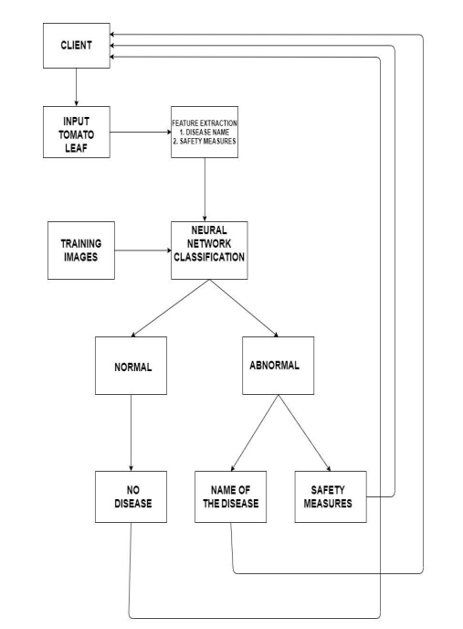
Proposed Solution
Algorithm used to predict the disease of the plant leaf is “Convolutional Neural Network”.
A CNN is well suitable for image recognition, designed to process pixel data.
The modules like Tensor flow, Keras are used.

Slide 8
CNN LAYERS
A CNN consists of an input layer and an output layer, as well as multiple hidden layers between them.
Input Layer:
The input layer’s shape is (150, 150, 3)
Convolution Layer:
The first - CONV1(filter=32,filter shape = 3*3, stride=1) layer
Output height = (Input height - Filter height + 2 * Padding) / Stride + 1 = (150-3+2*0)/(1+1) = 148
Output width = (Input width - Filter width + 2 * Padding) / Stride + 1 = (150-3+2*0)/(1+1) = 148
Parameters per filter = (filter height * filter width * input channels + 1) = (3*3*3+1)=28
Total parameters = Parameters per filter * number of filters = 28 *32 = 896
The second - CONV2(filter=64, filter shape =3*3, stride=1) layer.
The third - POOL1 layer has no parameters.
The fourth - DROPOUT1 layer has no parameters

Slide 9
CNN LAYERS
Layers:
The fifth - CONV3(filter = 64, filter shape =3*3, stride=1) layer has 36928 parameters.
The sixth - CONV4(filter = 64, filter shape =3*3, stride=1) layer has 36928 parameters.
The seventh - DROPOUT2 layer has 0 parameters.
The eight - POOL2 layer has no parameters.
The ninth - DROPOUT3 layer has 0 parameters.
The tenth - CONV5(filter = 128, filter shape =3*3, stride=1) layer has 73856 parameters.
The eleventh - CONV6(filter = 128, filter shape =3*3, stride=1) layer has 147584 parameters.
The twelfth - CONV7(filter = 128, filter shape =3*3, stride=1) layer has 147584 parameters.
The thirteenth - POOL3 layer has no parameters.
The fourteenth - DROPOUT4 layer has 0 parameters.

Slide 10
CNN layers
The fifteenth - CONV8(filter = 128, filter shape =3*3, stride=1) layer has 147584 parameters.
The sixteenth - CONV9(filter = 256, filter shape =3*3, stride=1) layer has 296168 parameters.
The seventeenth - POOL4 layer has 0 parameters.
The eighteenth - DROPOUT5 layer has 0 parameters.
The nineteenth - FLATTEN1 layer has 0 parameters.
The twentieth – CONV10(filter = 512, filter shape =3*3, stride=1) layer has 3277312 parameters.
The twenty first – CONV11(filter = 512, filter shape =3*3, stride=1) layer has 262656 parameters.
The twenty second - DROPOUT6 layer has 0 parameters.
Output layer:
In this, the input from the other layers is flattened and produces the output
The Softmax layer has (Parameters per neuron * number of neurons) parameters = (512+1) * 10 = 5130

Slide 11
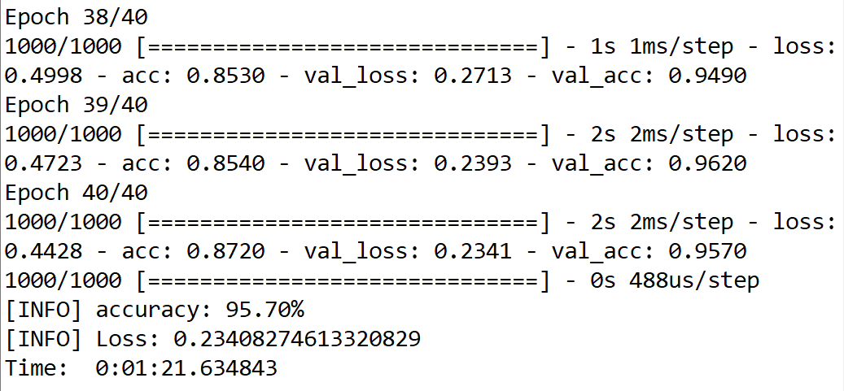
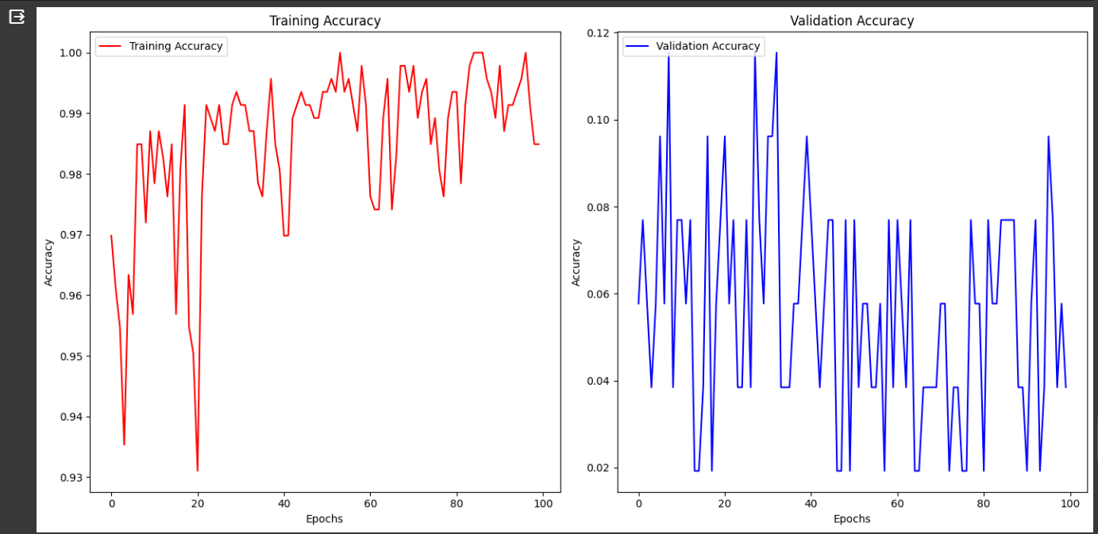
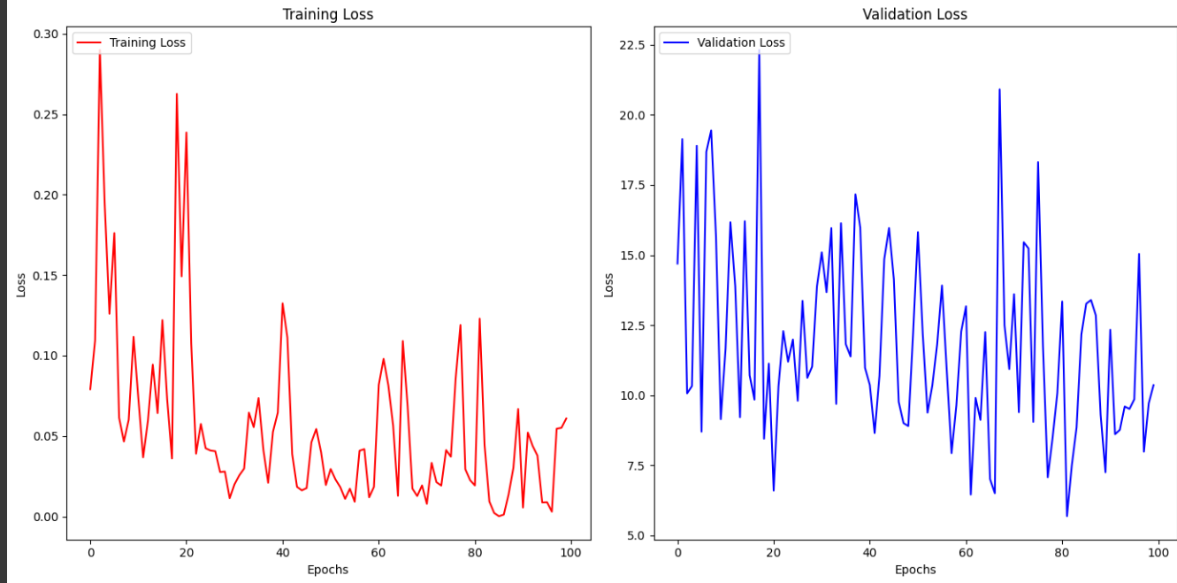
Results/SIMULATIONS

Slide 12
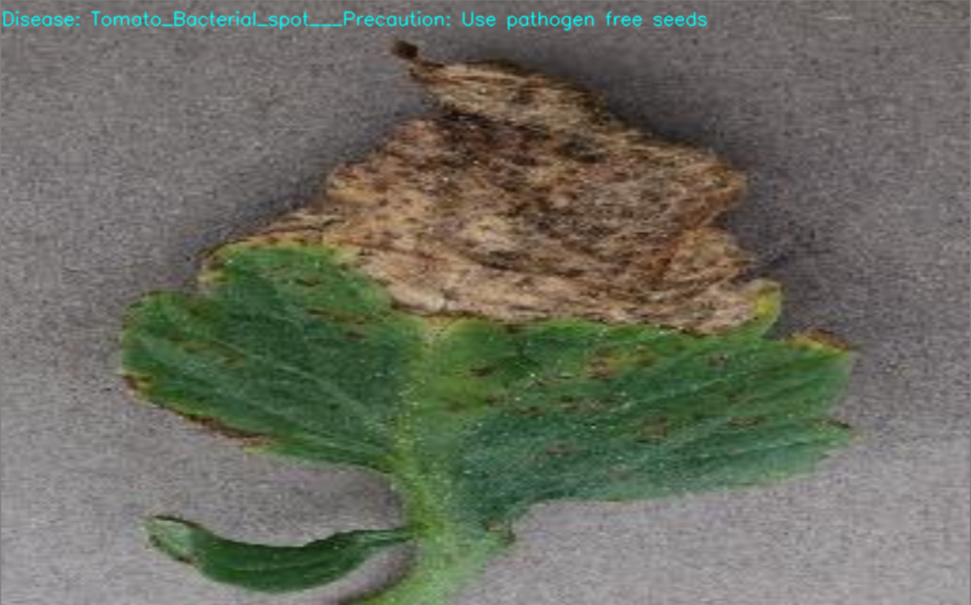
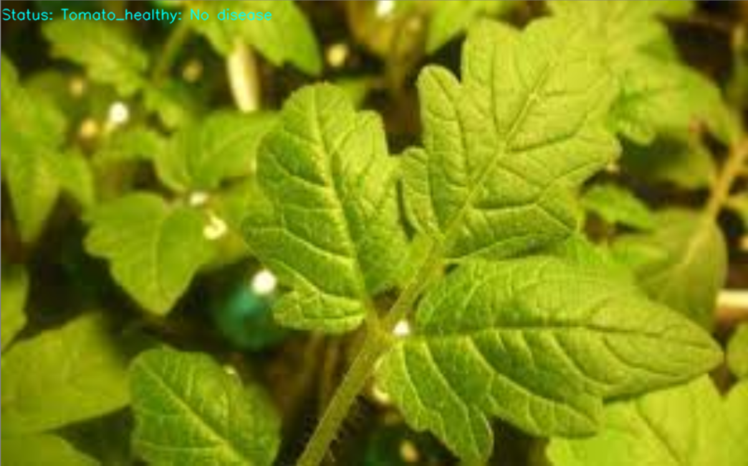
Testing OUTPUT

Slide 13
References
Prajwala TM, Alla Pranathi, Kandiraju et “Tomato Leaf Disease Detection Using Convolutional Neural Networks”, Eleventh International Conference on Contemporary Computing (IC3), (2018).
Suma V, R among Shetty, Rishab F Tated, Sunil Rohan, Triveni S Pujar, “CNN based Leaf Disease Identification And Remedy Recommendation System”, 3rd International Conference on Electronics, Communication and Aerospace Technology (ICECA), (2019).
Azeddine Elhassouny. Florentin Smarandache, ”Smart Mobile Application To Recognize Tomato Leaf Disease Using Convolutional Neural Networks”, International Conference of Computer Science and Renewable Energies (ICCSRE), (2019).
Akshay kumar, Vani M, “Image Based tomato Leaf Disease Detection”, 10th International Conference on Computing, Communication and Networking Technologies (ICCCNT), (2019).
Ramesh Medar, Vijay S. Rajpurohit, Shweta, “Crop Yield Prediction Using Machine Learning Techniques”, IEEE 5th International Conference for Convergence in Technology (I2CT), (2019).
Peng Jiang, Yuehan Chen, Bin Liu, Dongjian He, Chunquan Liang, “Real Tme Detection Of Apple Leaf Diseases Using Deep Learning Approach Based On Improved Convolutional Neural Networks”, Advanced Optical Imaging for Extreme Environments, Volume: 7, (2019).

